Slide 1
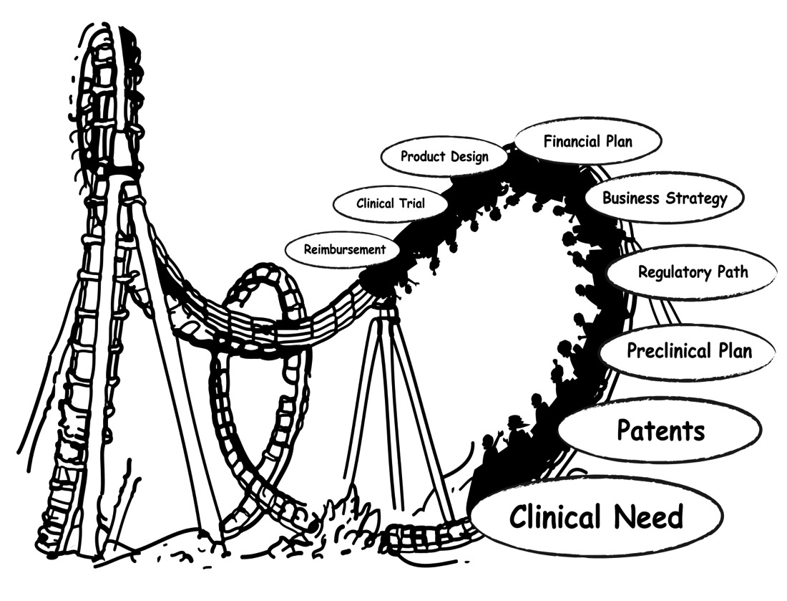

Translational Medicine Symposium 2014:
The Roller Coaster Ride to the Clinic

Slide 2
Translational Medicine Symposium 2014
Preclinical Development
Bench to Business to Bedside:
Clearing the Hurdles to the Clinic

Slide 3
Introductions
Moderator:
  Barbara Wirostko M.D. (Moran Eye Institute, CSO Jade Therapeutics, Inc.)
Panelists:
  Robert Selliah Ph.D. ( CEO American MedChem Nonprofit Corporation)
  Flagg Flanagan, Ph.D. – President & CEO, Discgenics

Slide 4
Discussion Points
Diseases, Mechanisms, Signaling Pathways & Targets
Drug Discovery toward Preclinical Candidate Selection
IND enabling Studies toward IND Filing & Clinic

Slide 5
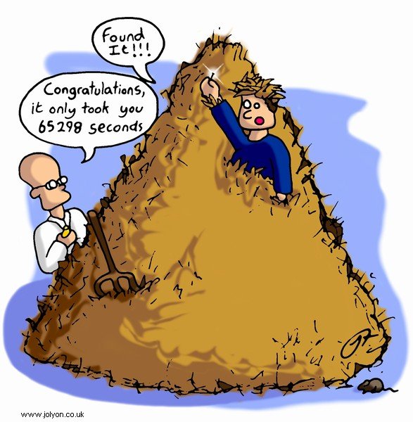
Drug Discovery and Development
How are drugs discovered and developed?
Translational Medicine Workshop: Preclinical Development
5

Slide 6
A Slow and Costly Process
Stage 1
Drug Discovery
Stage 2
Preclinical
Stage 3
Clinical Trials
Stage 4
FDA Review
Phase 1
20-100 Volunteers
Phase 3
1,000-5,000 Volunteers
1
FDA
Approved
Drug
10,000
Compounds
250
Compounds
IND Submission
5 Compounds
NDA Submitted
Phase 2
100-500 Volunteers
6.5 Years
7 Years
1.5 Years
Source: Pharmaceutical Research and Manufacturers of America
Translational Medicine Workshop: Preclinical Development
6

Slide 7
Why Compounds Fail or Slow Down in Development
SLOWED
DEVELOPMENT
FAILURE
Synthetic Complexity
Low Potency
Ambiguous Toxicity Finding
Inherently Time-Intensive Target Indication
Poor Biopharm Properties
Market Reasons
Lack of
Efficacy
Poor PK
Profile
Toxicity
Tufts Center for the Study of Drug Development, Tufts University
Translational Medicine Workshop: Preclinical Development
7

Slide 8
Drug Discovery to IND
Target Identification and Validation | Hit Identification | Lead Identification | Lead Optimization | Preclinical Development
Molecular target proposed/identified | High-Throughput Screening of compound library | Medicinal chemistry effort to turn “hits” into “leads” | Extensive med chem to improve potency and selectivity | GLP-compliant toxicology and PK studies
Biological hypothesis relevant to disease | Virtual or in silico screening | Potency and selectivity | In vivo efficacy in additional models | GLP-compliant safety pharmacology studies
Genetic models to demonstrate proof of concept | Confirm potency and selectivity of “hits” in 1º and 2º assays | In vitro PK: CYP inhibition, metabolic stability | In vivo PK characterization | Drug formulation
 | Initial in vitro pharmacokinetic (PK) assessment | In vivo efficacy in relevant animal models of disease | Initial dose-ranging toxicology studies | Pre-IND meeting with FDA
Translational Medicine Workshop: Preclinical Development
8

Slide 9

Identifying Drug Targets
Drug Targets
  Enzymes, receptors, protein-protein interactions (e.g gene, key enzyme, receptor, ion-channel, nuclear receptor)
  Biological system, signaling pathways
Translational Medicine Workshop: Preclinical Development
9

Slide 10
Discovery Biology
Disease of Interest (unmet medical need): understand the mechanism of disease and its progression
Identify a viable therapeutic target and validate
  Knock-out studies in whole cell or animal models
  RNAi, antibodies, tool compounds
Develop and validate robust biological assays for testing compounds
  Whole cell, transformed cells, cell-free biochemical
Translational Medicine Workshop: Preclinical Development
10
Notes:
Here is what we are trying to achieve (refer to slide).
Note that you can comment on:
We conduct basic animal health research in RY, but our animal health care products are marketed by Merial, a joint venture between Merck and Rhone- Poulenc (note that RP is now known as Aventis (RP merged with Hoechst).
Outcomes research is when we attempt to prove that our compounds not only cause important chemical effects in the body (such as reduced blood pressure or reduced cholesterol), but that these effects lead to reduced morbidity and mortality over time. The Zocor 4S study is an example.
The research budget for MRL is $2.4 billion this year.

Slide 11

Screening for Hit Identification
State-of-the-art technology is available to screen large libraries of compounds against various types biological assays
Compounds which affect the assay in a favorable manner are called “Hits”
Each set of hits are tested separately against the target assay to identify validated hits
Translational Medicine Workshop: Preclinical Development
11

Slide 12
Discovery Chemistry or Medicinal Chemistry – Iterative Process
Start with hits and create lead compounds (a.k.a., Hit-to-Lead, H2L)
  Synthesize and test analogs of hits to optimize certain properties: biological activity (potency), identify off target effects, selectivity (related or unrelated targets to avoid side effects or toxicity)
  Use drug design to create novel compounds and optimal compounds
    Computer-aided drug design (CADD)
    Intuitive drug design based on medicinal chemistry experience
  Novel compounds could result in valuable intellectual property (IP)
In vitro ADME characterization of optimized compounds
Explore proof of concept efficacy in animal models (non GLP)
Translational Medicine Workshop: Preclinical Development
12

Slide 13
Another Way to Find Leads – Modify Existing Active Compound
Many
steps
Design structural changes and create compounds to:
  Improve biological activity and selectivity for the target
  Eliminate side effects
  Carve out patent space (IP)
  Improve physicochemical properties
  Improve therapeutic index (TI) (effectiveness vs. unfavorable side effects)
Translational Medicine Workshop: Preclinical Development
13

Slide 14
Lead Optimization – Iterative Process
Identify optimal compound(s) for preclinical studies with favorable parameters
  synthetic scalability
  in vitro potency and selectivity
  In vivo efficacy in proof of concept and diseases models
  toxicology (dose-ranging toxicology studies in vivo)
  patentability
  In vivo pharmacokinetics (PK: half-life, Cmax, Tmax, etc)
  in vitro ADME characterization
  Optimal mode of delivery
Highly collaborative work with pharmacology, toxicology, biology, process chemistry, patent law, etc
Translational Medicine Workshop: Preclinical Development
14

Slide 15
Goal - Get to an IND Application (Investigational New Drug)
Stage 1
Drug Discovery
Stage 2
Preclinical
Stage 3
Clinical Trials
Stage 4
FDA Review
Phase 1
20-100 Volunteers
Phase 3
1,000-5,000 Volunteers
1
FDA
Approved
Drug
10,000
Compounds
250
Compounds
IND Submission
5 Compounds
NDA Submitted
Phase 2
100-500 Volunteers
6.5 Years
7 Years
1.5 Years
Source: Pharmaceutical Research and Manufacturers of America
Translational Medicine Workshop: Preclinical Development
15

Slide 16
IND process
What is an IND
What are GXP criteria
FDA expectations
Real life example

Slide 17
Investigational New Drug Application (IND)
Primary goal - present the data package to the FDA to allow the initiation of the clinical program:
  To present data to justify that the compound exhibits pharmacological activity to meet an unmet need,
  To support the product being reasonably safe for initial use in humans,
  To justify exposing humans to reasonable risks when used in limited, early-stage clinical studies.
http://www.fda.gov/Drugs/DevelopmentApprovalProcess/HowDrugsareDevelopedandApproved/ApprovalApplications/InvestigationalNewDrugINDApplication/default.htm#FDA Guidances for Investigational New Drugs
Translational Medicine Workshop: Preclinical Development
17

Slide 18
IND (Investigational New Drug) Application
The IND application must contain information in three broad areas:
Manufacturing Information (GMP) - Information pertaining to the composition, manufacturer, stability, and controls used for manufacturing the drug substance and the drug product. This information is assessed to ensure that the company can adequately produce and supply consistent batches of the drug.
Animal Pharmacology and Toxicology Studies (GLP) - Preclinical data to permit an assessment as to whether the product is reasonably safe for initial testing in humans. Also included are any previous experience with the drug in humans (often foreign use).
Clinical Protocols and Investigator Information (GCP)- Detailed protocols for proposed clinical studies to assess whether the initial-phase trials will expose subjects to unnecessary risks. Also, information on the qualifications of clinical investigators - professionals (generally physicians) who oversee the administration of the experimental compound - to assess whether they are qualified to fulfill their clinical trial duties. Finally, commitments to obtain informed consent from the research subjects, to obtain review of the study by an institutional review board (IRB), and to adhere to the investigational new drug regulations
http://www.fda.gov/Drugs/DevelopmentApprovalProcess/HowDrugsareDevelopedandApproved/ApprovalApplications/InvestigationalNewDrugINDApplication/default.htm#FDA Guidances for Investigational New Drugs
Translational Medicine Workshop: Preclinical Development
18

Slide 19
GxP Criteria
Quality systems and requirements (quality control and assurance (QC and QA)) that have been put into place to ensure the uniformity, consistency, reliability, quality and integrity of the product manufacturing, toxicology and clinical trial conduct.
GMP – Good Manufacturing Practice
GLP – Good Laboratory Practice
GCP – Good Clinical Practice
Code of Federal Regulations (CFR 21) http://www.fda.gov/ScienceResearch/SpecialTopics

Slide 20
IND Enabling Preclinical Studies
Efficacy pharmacology (animal models)
Safety pharmacology
General toxicology – oral and specific route of administration
Genetic toxicology (geno tox)
Pharmacokinetics (PK- local and systemic)
ADME (absorption, distribution, metabolism, excretion)
Reproductive toxicology
Carcinogenicity ( ask for a waiver based on genotox)
Special studies
Translational Medicine Workshop: Preclinical Development
20

Slide 21
IND Enabling Studies Needed
Will determine with FDA during the pre IND meeting
What studies are needed – dependent on product & indication
  Who are the patients ?
  What is the unmet need ?
  What is the expected dosing – acute or chronic?
  Where will it be delivered – systemic or local?
Need to demonstrate safety preclinically for that First in Human Study (FIH)

Slide 22
Ophthalmology: topical NCE
NCE (new chemical entity) for glaucoma
First study was a 28 day study in subjects WITH glaucoma > 45 yrs of age
  Systemic safety – 0ral in 2 species
  Local tolerability for 28 days in 2 species
  NCE – genotox studies (DNA damage)
  Older population (No reprotox for the first studies)
  Carcinogenicity studies during clinical development
  Chronic tox AHEAD of the longer phase 2/3 studies

Slide 23
Conclusion
Drug discovery from target identification to IND filing is a long process
Highly collaborative process – expertise comes from biology, genetics, medicinal chemistry, pharmacology, toxicology, process chemistry, computational design & regulatory
Yet, this is how we discover drugs which help heal patients, provide comfort, reduce pain, and allow for longer and improve quality of life

Slide 24
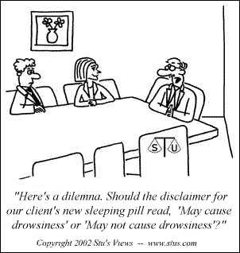
Q & A

Slide 25
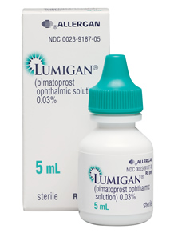

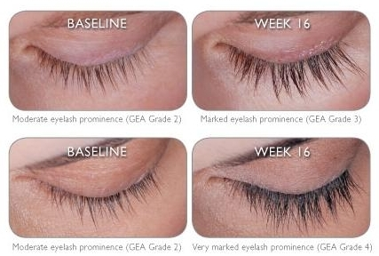
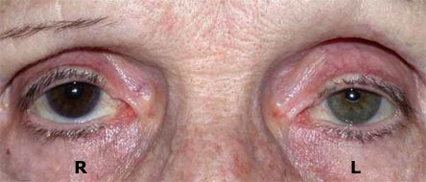
Finding the Lead (cont.)
Enhance a side effect
February 19, 2013
Translational Medicine Workshop: Preclinical Development
25

Slide 26
Pharmacology
In Vivo animal models to demonstrate efficacy
  Efficacy studies are conducted more for candidate selection/ prioritization
Understanding the pharmacology impacts interpretation of toxicology studies
February 19, 2013
Translational Medicine Workshop: Preclinical Development
26

Slide 27
Safety Pharmacology
Investigate potential undesirable pharmacodynamic effects on the physiological function of vital organs
  Generally given at higher than indicated dose orally
Core battery
  Cardiovascular system
  Respiratory system
  Central nervous system
February 19, 2013
Translational Medicine Workshop: Preclinical Development
27

Slide 28
General Toxicology
Pivotal to determining whether the proposed clinical trial is safe to proceed
  Identify toxicities (doses) to be avoided
  Direct monitoring in the clinic
  Calculate safety margins (exposure at the NOAEL/ clinical exposure)
Species selection
Dose selection
Duration of administration
Route of administration
Endpoints
February 19, 2013
Translational Medicine Workshop: Preclinical Development
28

Slide 29
General Toxicology
Species Selection
Two species including one rodent
  Typically mouse or rat and dog or primate
Metabolic profile should be similar to human
  Rodent specific metabolite could lead to a positive genotox signal (clastogen or anagen)
February 19, 2013
Translational Medicine Workshop: Preclinical Development
29

Slide 30
General Toxicology
Dose Selection
Selection 1
  Dosing should be up to Maximum Tolerated Dose
  Dosing should include a No Adverse Effect level (NOAEL)
  Doses should be spaced so to allow a dose response assessment
  Generally 3 dose groups and a control group
Selection 2
  Dosing should NOT be determined merely by multiples of the human dose
  Dosing regimen can be adjusted to mimic human exposure
    If t ½ is shorter in animals than humans such that exposure with daily dosing is limited, give drug multiple times per day
February 19, 2013
Translational Medicine Workshop: Preclinical Development
30

Slide 31
General Toxicology
Duration of Dosing
For initial clinical trials – (up to 2 weeks duration) 2 weeks toxicology studies needed
For later clinical trials, animal studies must be of equal duration
  Can be managed sequentially if preclinical is run staggered with clinical
    Need to discuss with FDA
February 19, 2013
Translational Medicine Workshop: Preclinical Development
31

Slide 32
General Toxicology
Route of administration
Same as clinical route
If adequate systemic exposure cannot be achieved by the clinical route supplement with systemic dosing
  There does exist evidence that Avastin gets into the systemic vasculature with ocular dosing
February 19, 2013
Translational Medicine Workshop: Preclinical Development
32

Slide 33
General Toxicology
Endpoints
Mortality
Clinical signs
Body weight, temperature, activity level
Hematology
Clinical chemistry
Toxicokinetics
Pathology (complete battery of tissues)
February 19, 2013
Translational Medicine Workshop: Preclinical Development
33

Slide 34
Genetic Toxicology
Core battery of tests
  Microbial mutation test (AMES)
  In vitro mammalian chromosomal aberration or mouse lymphoma tk test
  In vivo micronucleus test ( clastogen or anagen)
First 2 submitted with initial IND
Last test submitted prior to Phase 2
Positive signal may lead to additional testing
Data conveyed in the label
February 19, 2013
Translational Medicine Workshop: Preclinical Development
34

Slide 35
Pharmacokinetics
Parameters include AUC, Cmax, Tmax t ½, CI< vol of distribution
Exposure parameters allow comparisons to be made with clinical data so that safety margins can be calculated
Single and repeat dose studies to address accumulation and induction of metabolism
February 19, 2013
Translational Medicine Workshop: Preclinical Development
35

Slide 36
Reproductive Toxicology
Three types of studies
  Fertility and early embryonic development
  Embryofetal development
  Peri and post natal development
Combined studies are acceptable but require complex designs
Data will be conveyed in the drug label
February 19, 2013
Translational Medicine Workshop: Preclinical Development
36

Slide 37
Carcinogenicity
Performed for Chronic use drugs
  Continuous use for 6 months or more
  Chronic intermittent use
Performed for drugs for which there is concern based on
  Drug class
  Structure activity relationship
  Preneoplastic lesions identified in the tox studies
  Long term tissue retension
Long Studies - start early in clinical development
February 19, 2013
Translational Medicine Workshop: Preclinical Development
37

Slide 38
IND (Investigation New Drug) Application
The following regulations apply to the IND application process:
21CFR Part 312 Investigational New Drug Application
21CFR Part 314 INDA and NDA Applications for FDA Approval to Market a New Drug
(New Drug Approval)
21CFR Part 316 Orphan Drugs
21CFR Part 58 Good Lab Practice for Nonclinical Laboratory [Animal] Studies
21CFR Part 50 Protection of Human Subjects
21CFR Part 56 Institutional Review Boards
21CFR Part 201 Drug Labeling
21CFR Part 54 Financial Disclosure by Clinical Investigators
http://www.fda.gov/Drugs/DevelopmentApprovalProcess/HowDrugsareDevelopedandApproved/ApprovalApplications/InvestigationalNewDrugINDApplication/default.htm#FDA Guidances for Investigational New Drugs
February 19, 2013
Translational Medicine Workshop: Preclinical Development
38

Slide 39
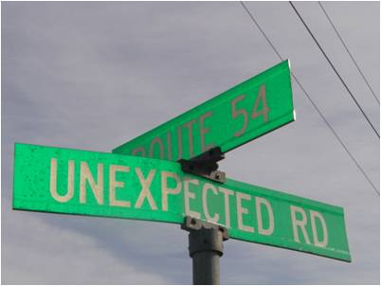
Serendipity: a chance occurrence
Must be accompanied by an experimentalist who understands the “big picture” (and is not solely focused on his/her immediate research goal), who has an open mind toward unexpected results, and who has the ability to use deductive logic in the explanation of such results.
Example: Penicillin discovery
Example: development of Viagra to treat erectile dysfunction
February 19, 2013
Translational Medicine Workshop: Preclinical Development
39

